Slide 1
INFX 504 Number Conversion Tools
By
Bob Larson

Slide 2
Topics
Many Web Tools
Rapid Tables Example
Microsoft Windows 10 Calculator
Microsoft Calculator Plus

Slide 3
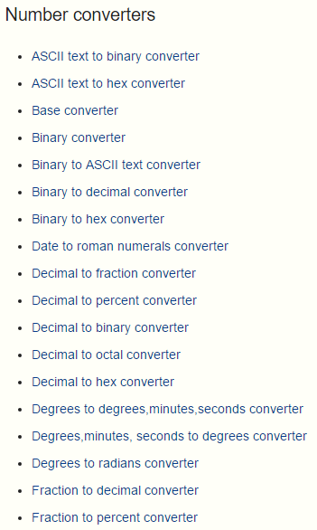
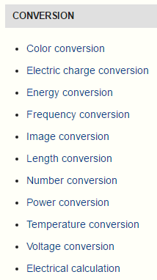
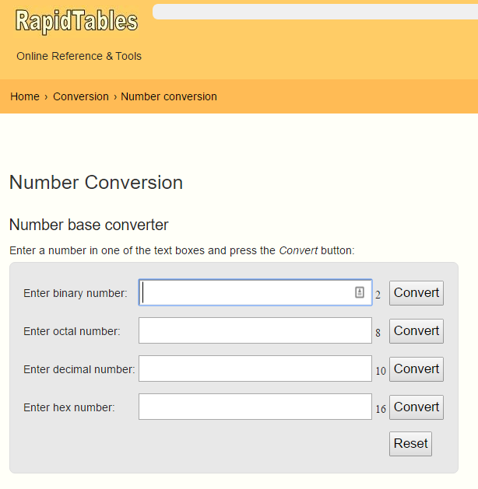
Many Web Tools
Enter any one type of number, press Convert, it calculates the rest.
http://rapidtables.com/

Slide 4
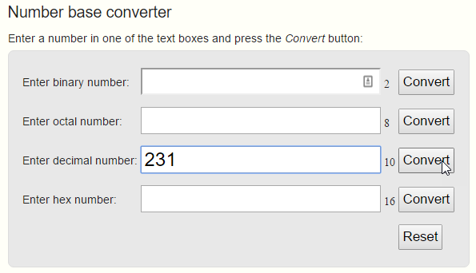
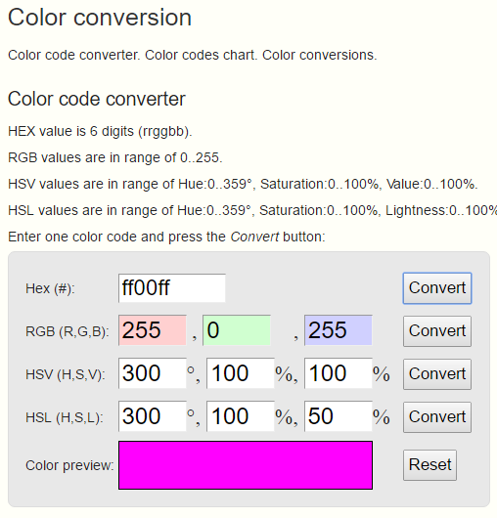
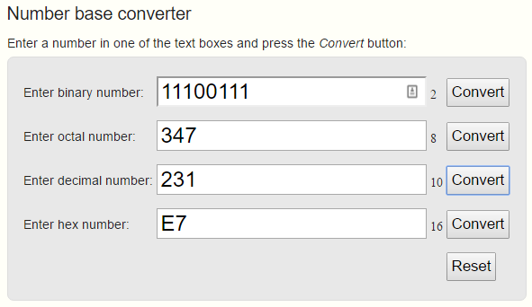
Rapid Tables Example

Slide 5
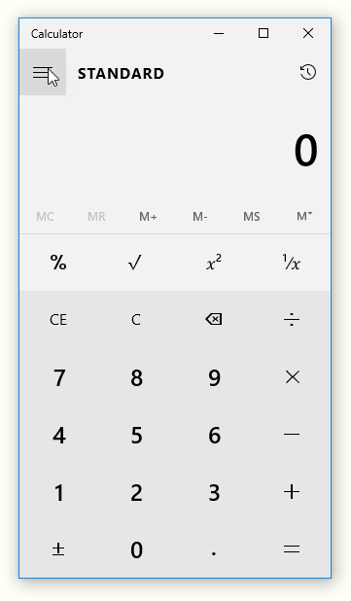
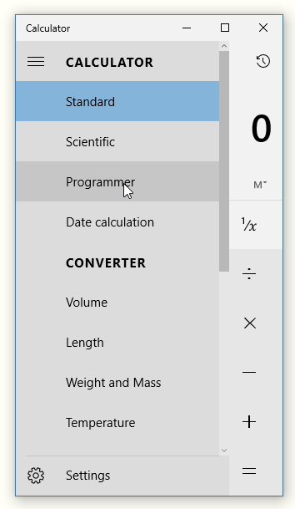
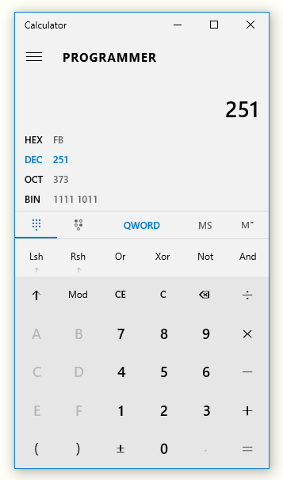
Microsoft Windows 10 Calculator
1
2
3
Choose entry type

Slide 6
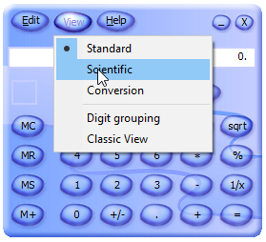
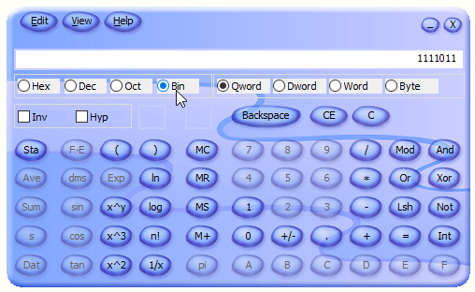
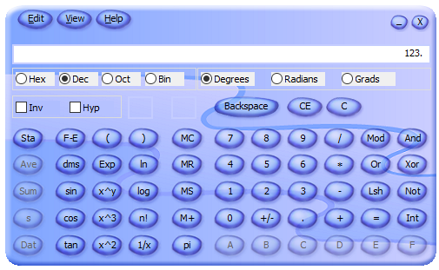
Microsoft Calculator Plus
Google microsoft calculator plus

Slide 7
Fin…

